Slide 1



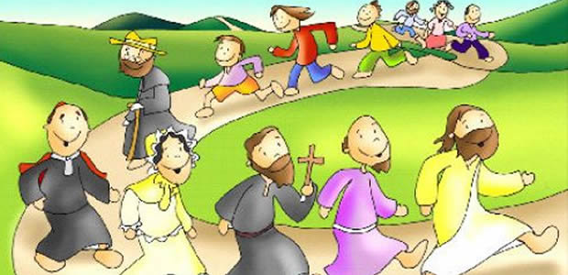

The Call to Holiness
The Call to Holiness

Slide 2
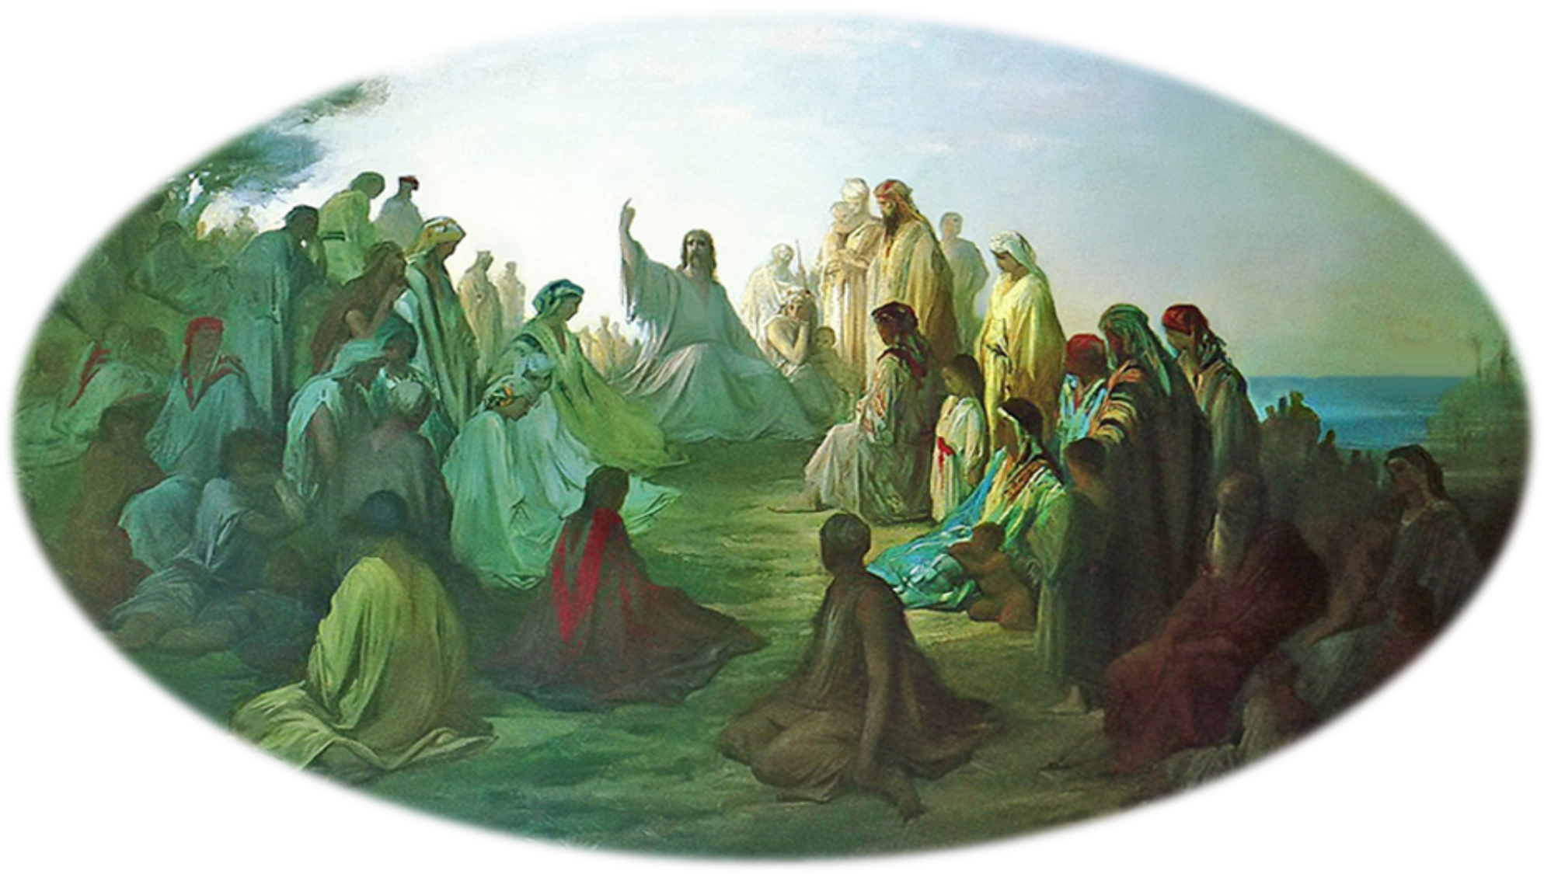

Jesus says, “Rejoice and Be Glad”Mt 5,12

Slide 3

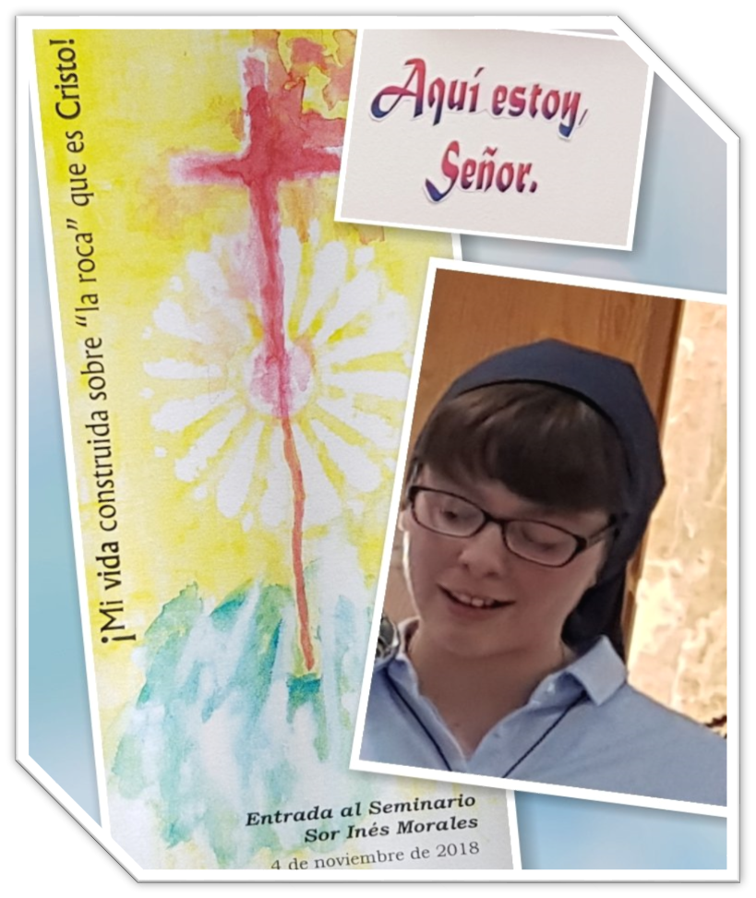
The Lord asks everything of us,
Here I Am.
Lord
and in return
he offers us true life,
the happiness for which
we were created.

Slide 4
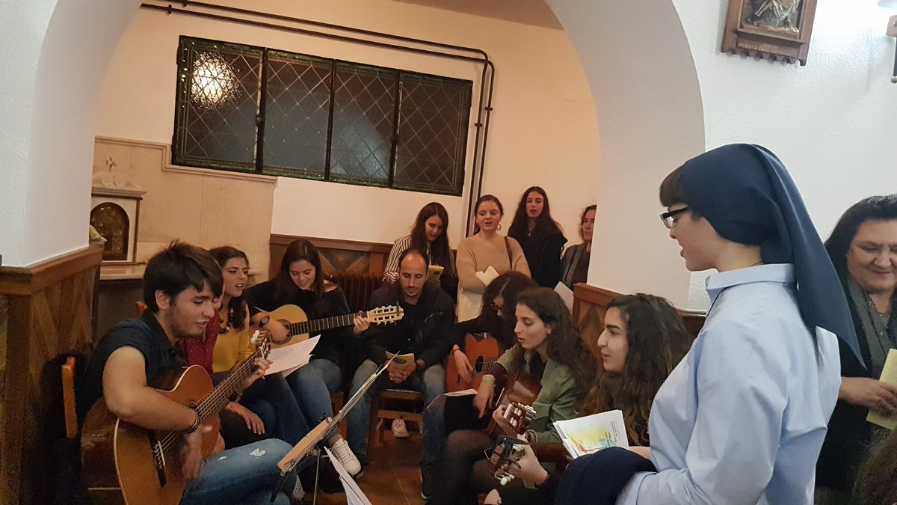
For the Lord has chosen each one of us
“to be holy and blameless before him in love.”
Eph 1:4

Slide 5


The Letter to the Hebrews presents a number of testimonies that encourage us to “run with perseverance the race that is set before us.”
(12:1)

Slide 6

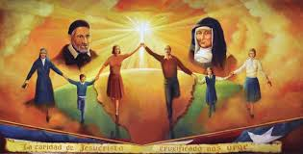
it invites us to realize that “a great cloud of witnesses”
impels us to advance constantly towards the goal.

Slide 7
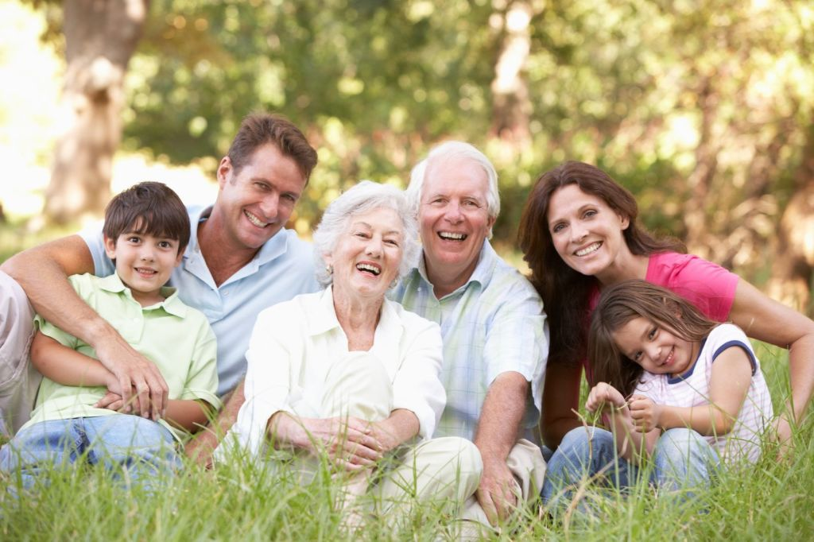

These witnesses may include our own mothers, grandmothers or other loved ones.
(cf. 2 Tim 1, 5).

Slide 8
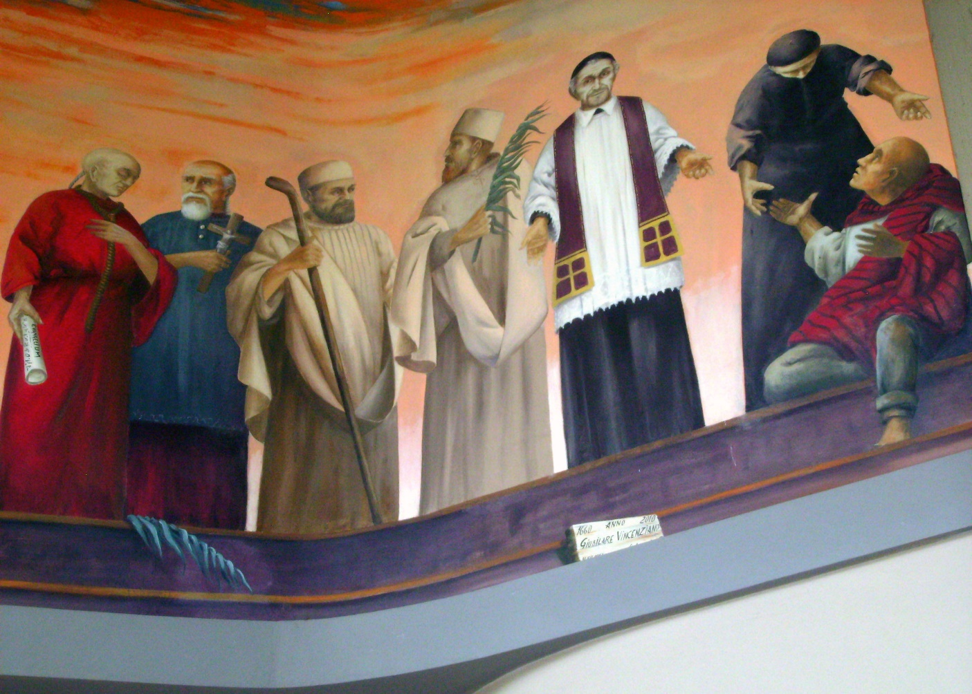
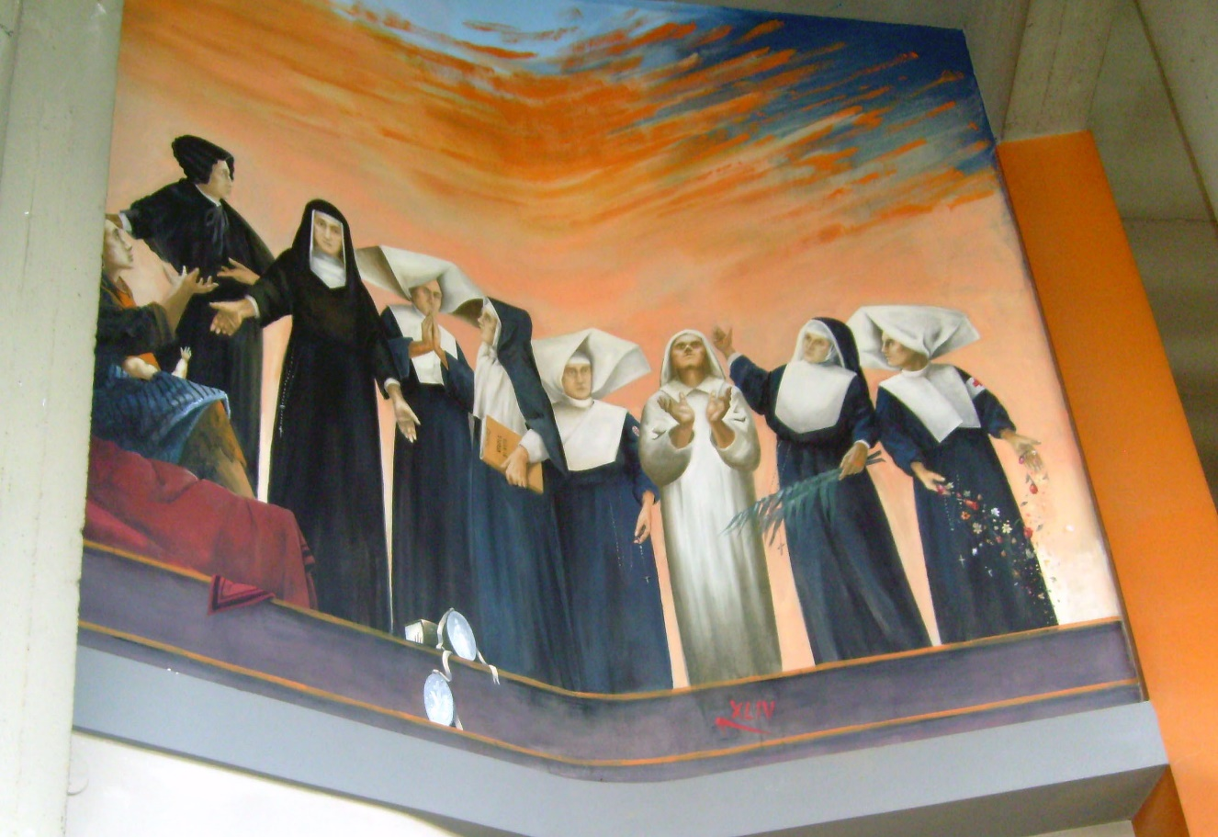
The saints now in God’s presence
preserve their bonds of love and communion with us.

Slide 9
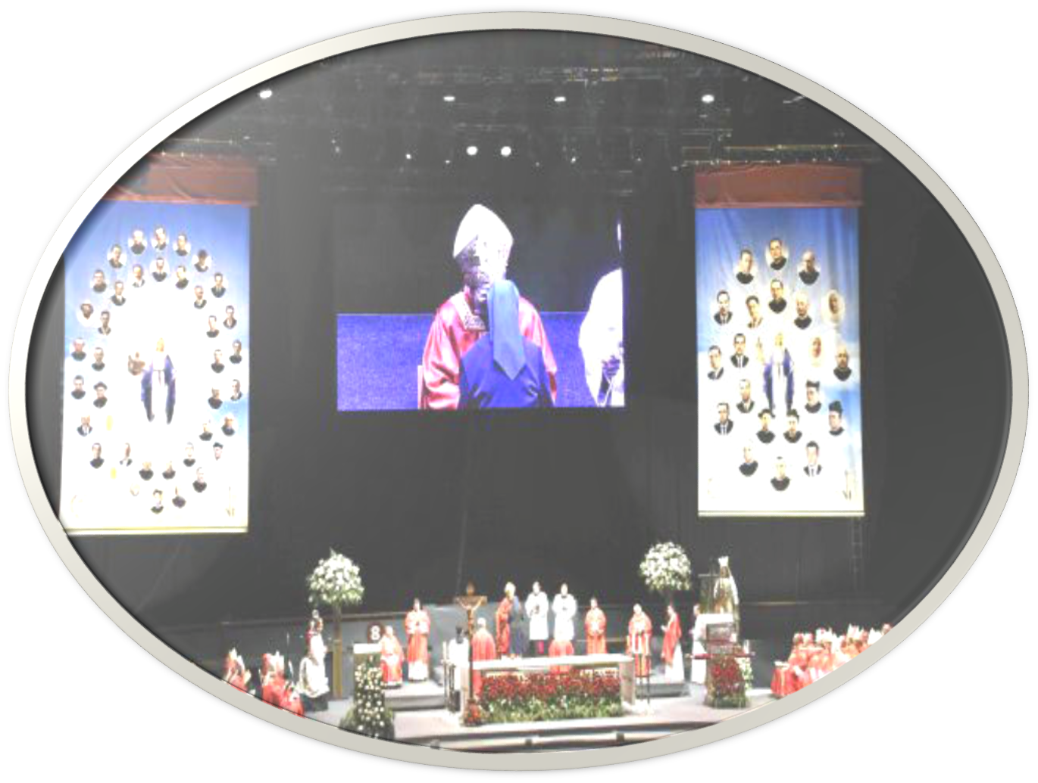
The processes of beatification and canonization recognize the signs of heroic virtue,

Slide 10
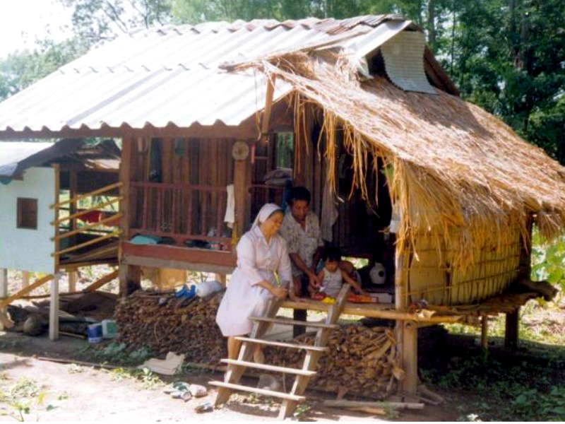
the sacrifice of one’s life in martyrdom, and certain cases where a life is constantly offered for others, even until death.

Slide 11
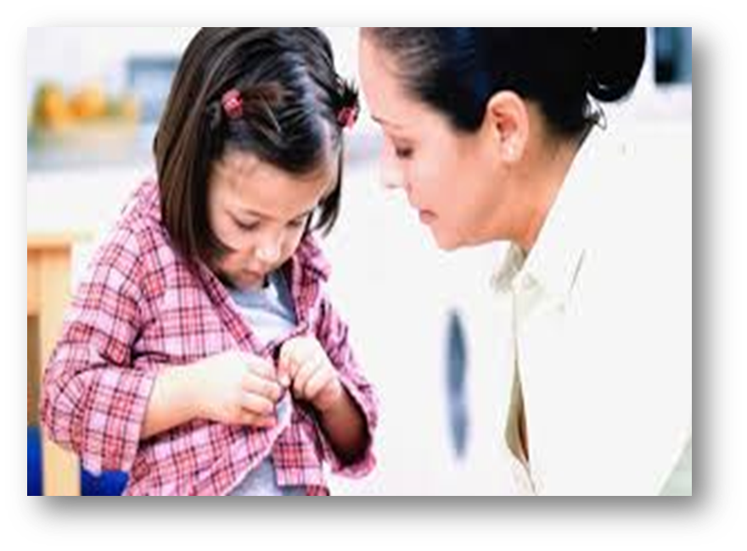
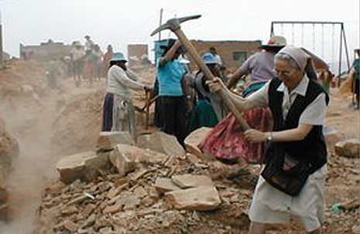
“The Saints Next Door”
We need not think only of those already beatified and canonized.

Slide 12
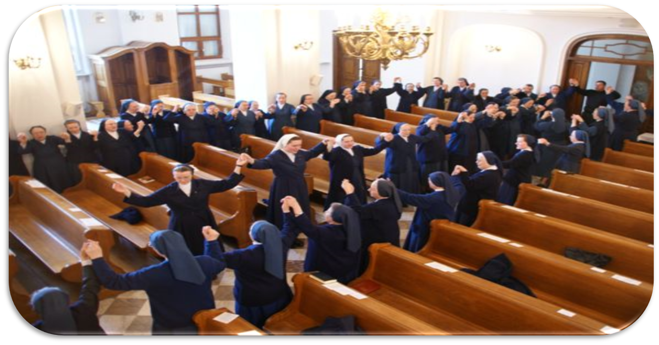
“it has pleased God to make men and women holy and to save them,

Slide 13
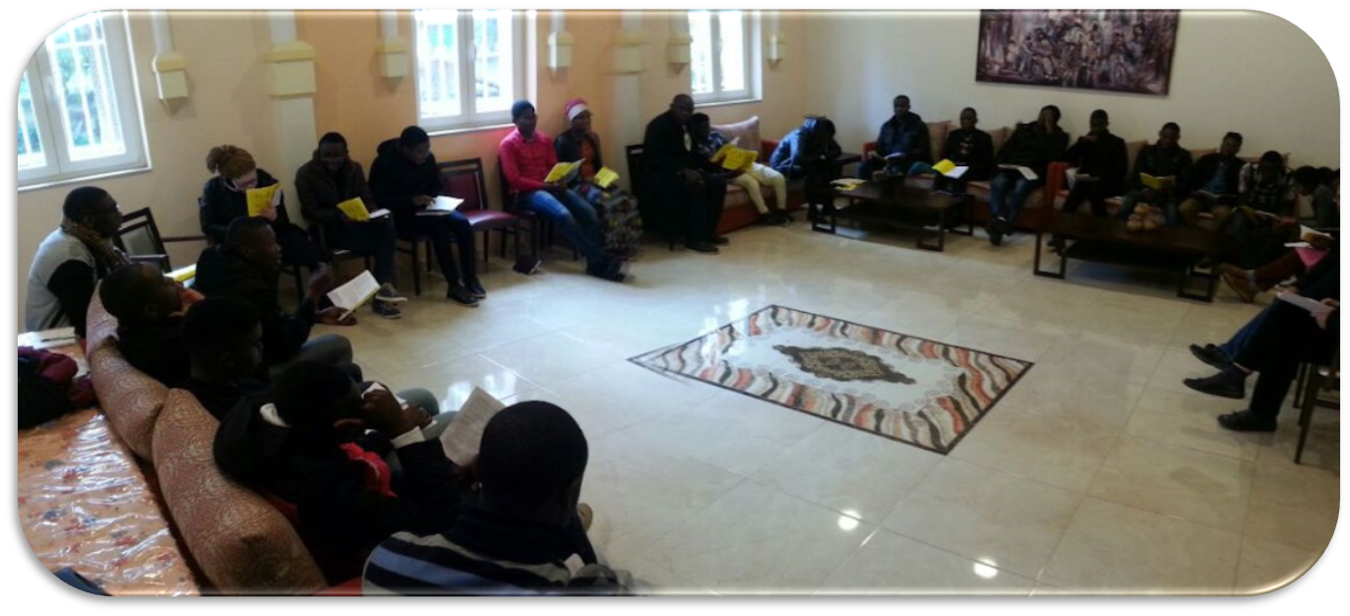
not as individuals without any bond between them, but rather as a people who might acknowledge him in truth and serve him in holiness.”

Slide 14
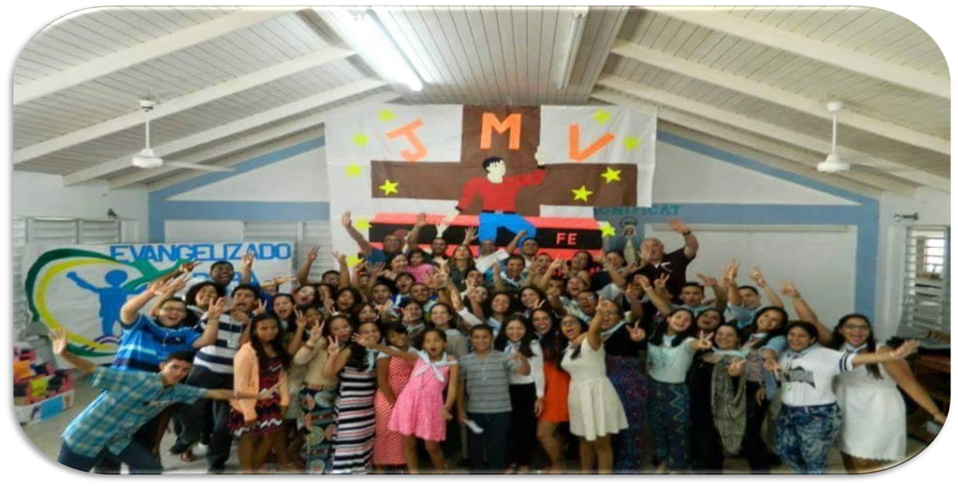
In salvation history, the Lord saved one people.

Slide 15

We are never completely ourselves unless we belong to a people… no one is saved alone, as an isolated individual.

Slide 16
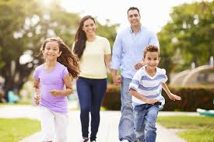
God draws us to himself, taking into account the complex fabric of interpersonal relationships present in a human community,
in those parents who raise their children with immense love,

Slide 17
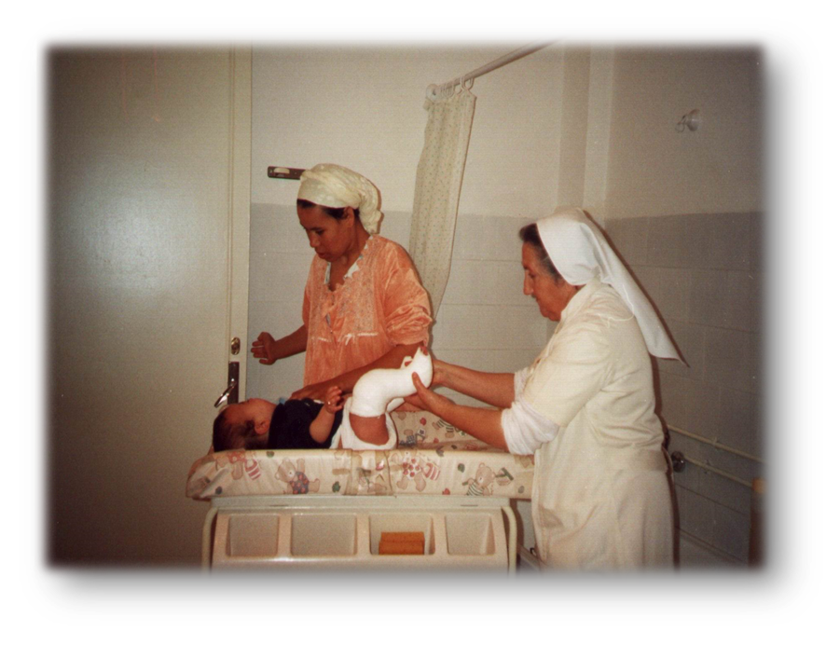
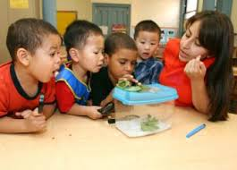
…in those men and women who work hard to support their families, in the sick,

Slide 18
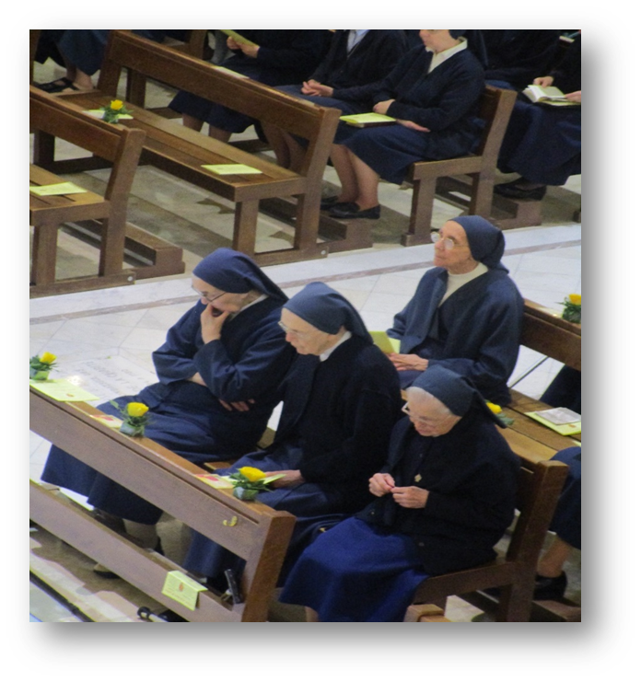
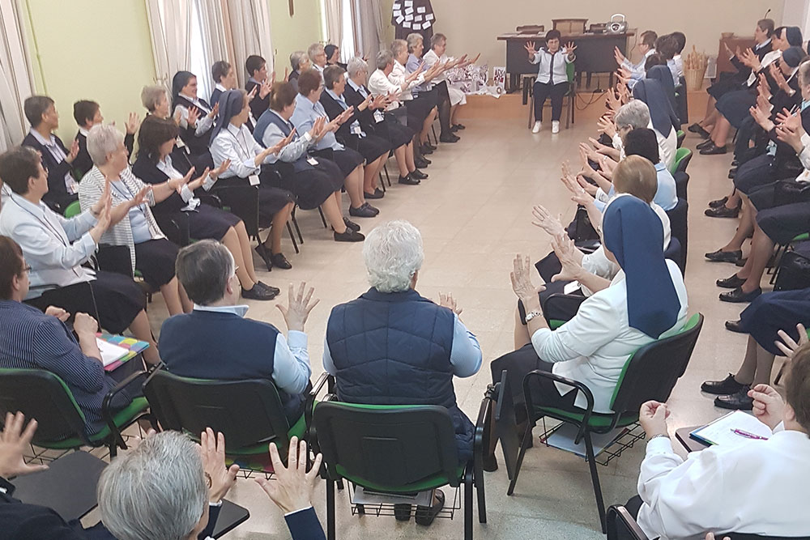
…in elderly religious who never lose their smile. In their daily perseverance

Slide 19

I see the holiness of the Church militant. Very often it is a holiness found in our next-door neighbours,
those who, living in our midst, reflect God’s presence. We might call them “the middle class of holiness”.

Slide 20
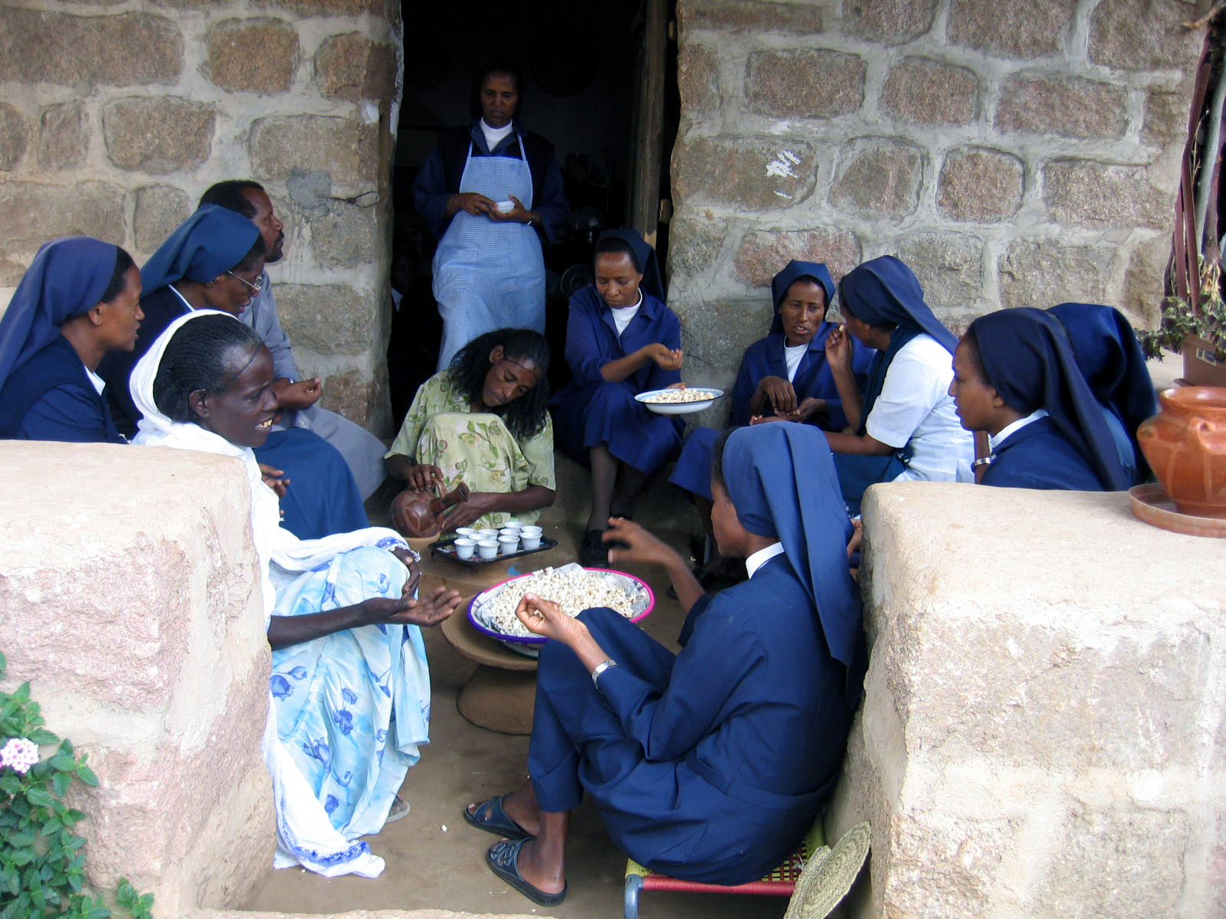

Let us be spurred on by the signs of holiness
that the Lord shows us through the humblest members of that people.

Slide 21

Holiness is the most attractive face of the Church.
But even outside the Catholic Church and in very different contexts, the Holy Spirit raises up “signs of his presence which help Christ’s followers.”

Slide 22
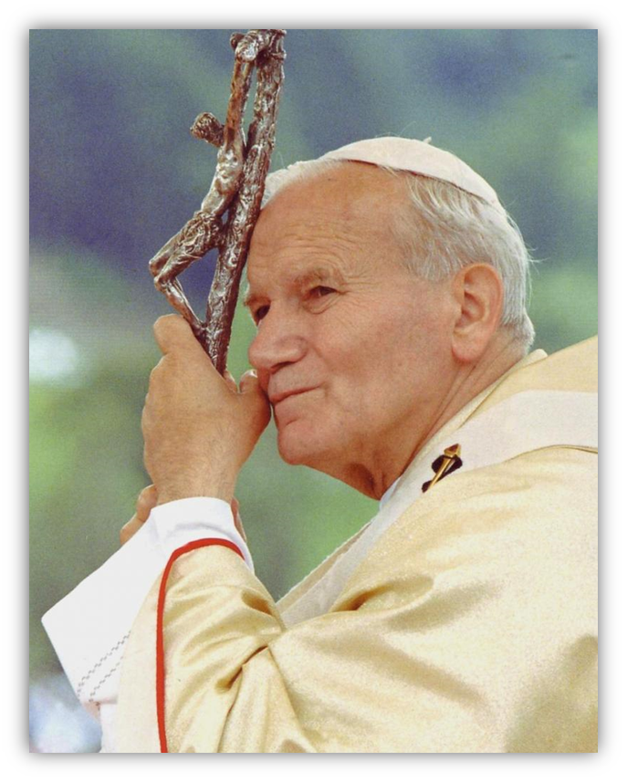
Saint John Paul II reminded us that “the witness to Christ borne even to the shedding of blood has become a common inheritance of Catholics, Orthodox, Anglicans and Protestants.”

Slide 23

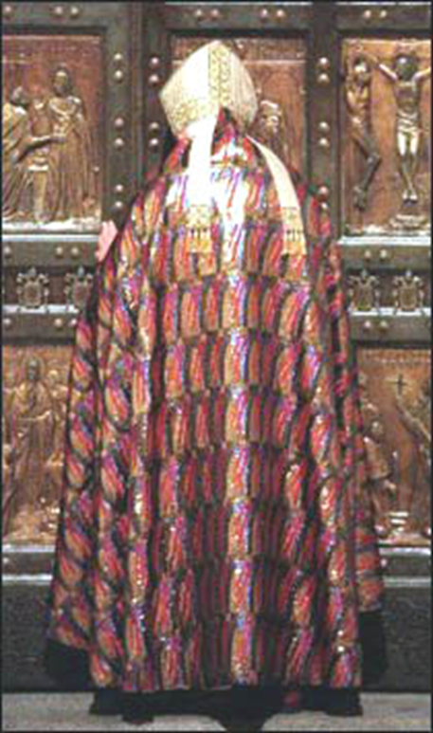
In the moving ecumenical commemoration held in the Colosseum during the Great Jubilee of the Year 2000, he stated that the martyrs are “a heritage which speaks more powerfully than all the causes of division.”

Slide 24
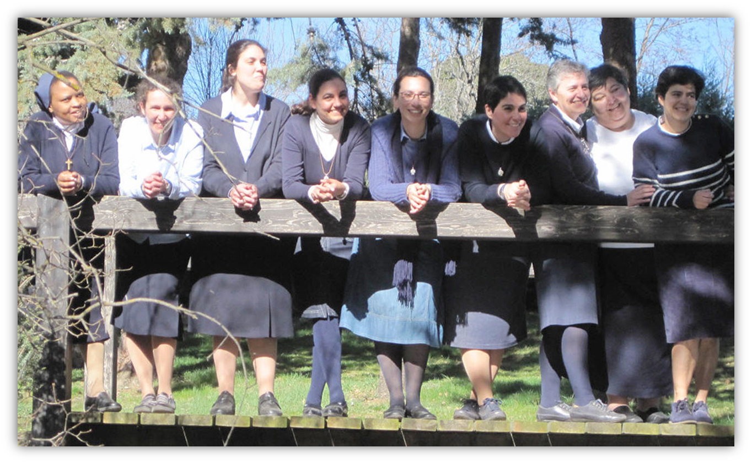
The Lord Calls. All this is important.

Slide 25

I would like to insist primarily on the call to holiness that the Lord addresses to each of us,
the call that he also addresses, personally, to you:

Slide 26
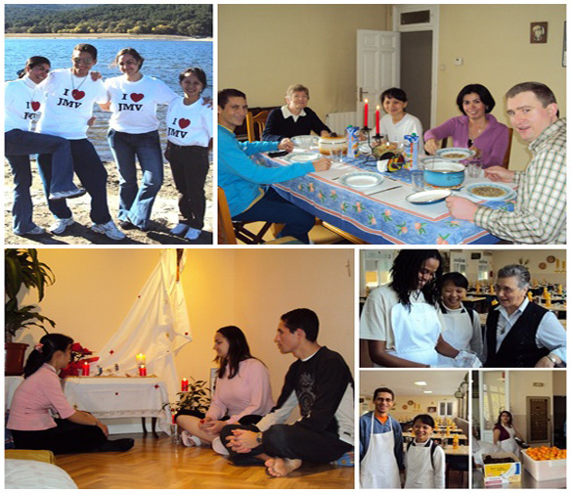

“Be holy, for I am holy.”
You too need to see the entirety of your life as a mission.

Slide 27
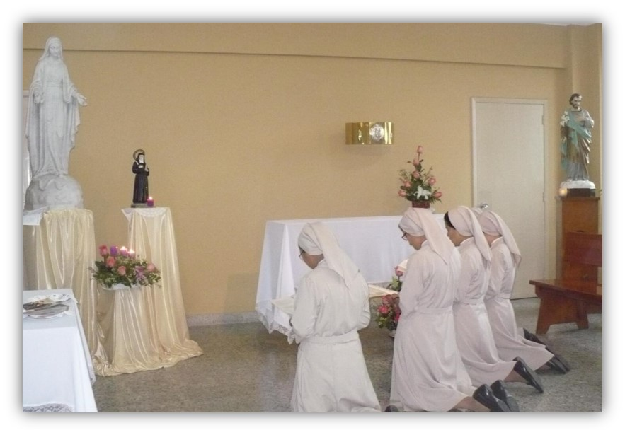
Try to do so by listening to God in prayer and recognizing the signs that he gives you.
Always ask the Spirit what Jesus expects from you at every moment of your life and in every decision you must make, so as to discern its place in the mission you have received.

Slide 28
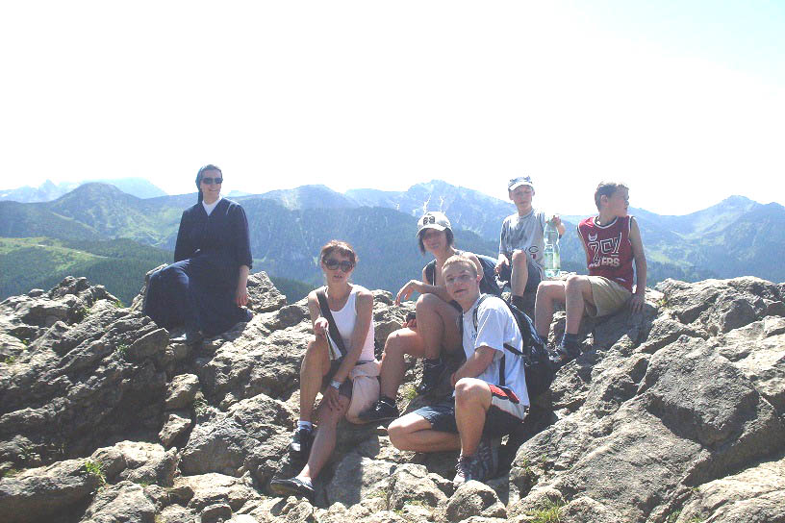
Allow the Spirit to forge in you the personal mystery that can reflect Jesus Christ in today’s world.

Slide 29
Daughters of Charity of St. Vincent de Paul
January 2019
Text: Apostolic Exhortation: On the Call to Holiness
Music: Darin Sysoev – Moments and Rainbow - Robinson

